Slide 1
Food Calorie Labels How accurate are they?
Rakesh Sunkari
Bheeni Garg
Pallavi Jogal

Slide 2
Introduction
Food items claiming to be "lite," "reduced-calorie," "low-calorie," "diet," "low-fat," "no-fat," or "health" foods.
Each food is classified based on its distribution as either nationally advertised, regionally distributed, or locally prepared.
From the work published by Allison, D., Heshka, S., Sepulveda, D., and Heymsfield, S. (1993), "Counting Calories - Caveat Emptor," Journal of the American Medical Association (JAMA), v. 270, pp. 1454-1456

Slide 3
Data
Per Gram (% Difference)
National | Regional | Local
-2 | 42 | NA
-1 | 38 | NA
-4.5 | -16 | NA
4 | 5 | NA
5 | 11 | NA
-12 | 7 | NA
1 | 12 | NA
9 | 21 | NA
10 | -13
-6 | 13
-6 | 16
-17 | 40
7
4
-4
-11
14
-1
-10.5
2
Per Item (% Difference)
National | Regional | Local
2 | 41 | 15
-28 | 46 | 60
-6 | 2 | 250
8 | 25 | 145
6 | 39 | 6
-1 | 16.5 | 80
10 | 17 | 95
13 | 28 | 3
15 | -3
-4 | 14
-4 | 34
-18 | 42
10
5
3
-7
3
-0.5
-10
6
NA – Not Available. Per Gram data for Locally prepared food was not provided
Per gram: Percentage difference between measured calories and labeled calories per gram
= ( (measured-labeled)/labeled) x 100%
Per item: Percentage difference between measured calories and labeled calories per item
Classification: Nationally advertised, Regionally distributed and Locally prepared
NOTE:

Slide 4
Objective
Accuracy of caloric labeling of foods i.e. the degree of underreporting /over reporting of calories for per gram and per item for each category
Is there any difference in caloric labeling per gram between given two categories?
Is there any difference in caloric labeling per item among three categories?

Slide 5
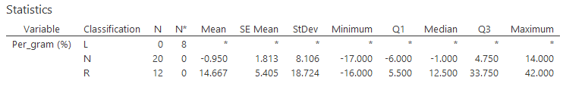
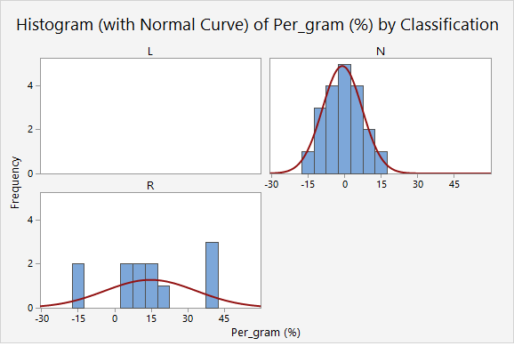
Statistics: Per gram (%)

Slide 6
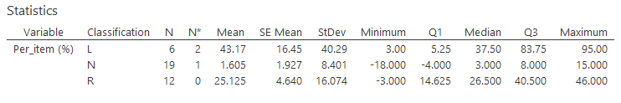
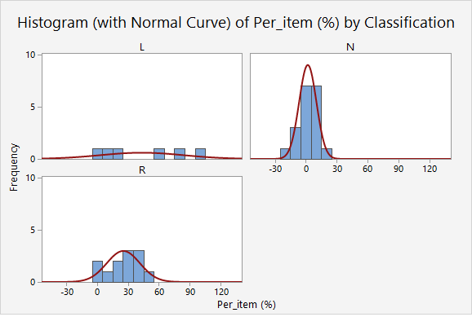
Statistics: Per Item (%)

Slide 7
For per gram
One sample t test
and
Two sample t test

Slide 8
Checking normality for per gram

Slide 9
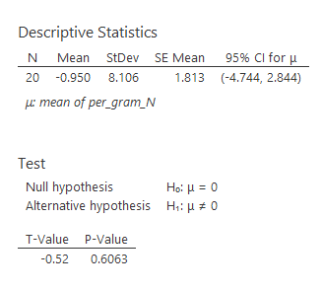
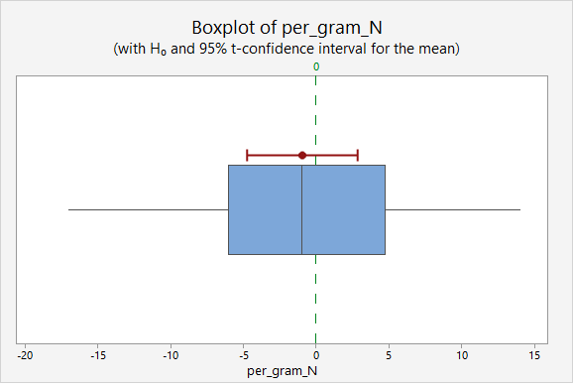
Per Gram : One-Sample t test for Nationally advertised food

Slide 10
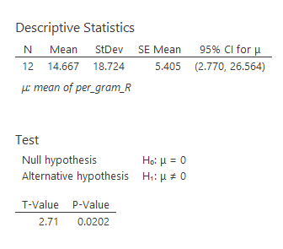
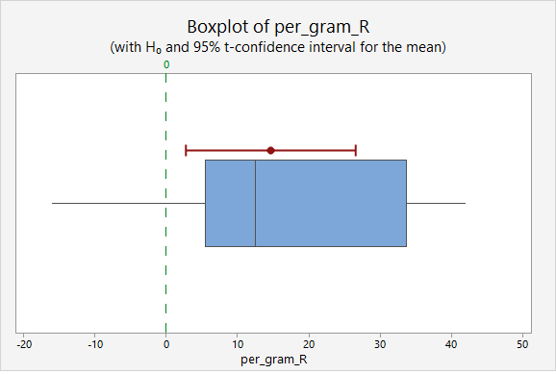
Per Gram : One-Sample t test for Regionally distributed food

Slide 11
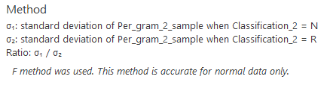
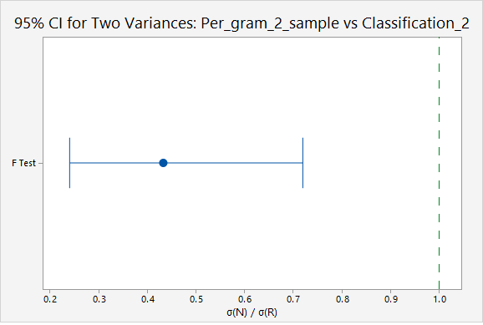
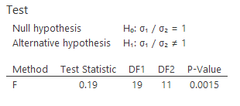
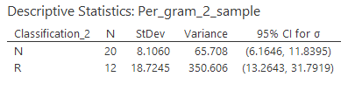
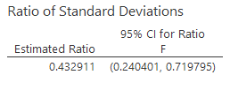
Per Gram: 2 Sample Variances test

Slide 12
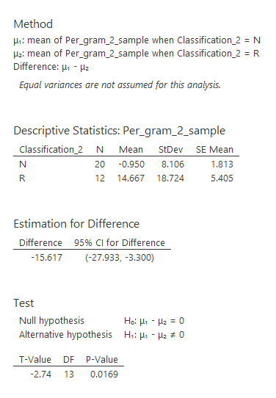
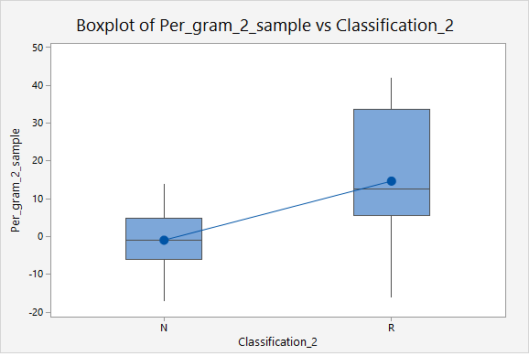
Per Gram : Two-Sample t test for checking Differences between Nationally advertised and Regionally distributed food

Slide 13
For per item
One sample t test
ANOVA
Kruskal-Wallis Test

Slide 15
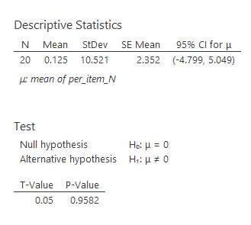
Per Item : One-Sample t test for Nationally advertised food

Slide 16
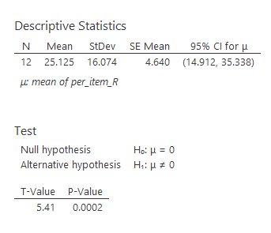
Per Item : One-Sample t test for Regionally distributed food

Slide 17
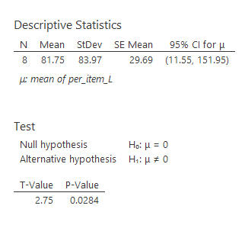
Per Item : One-Sample t test for Locally prepared food

Slide 18

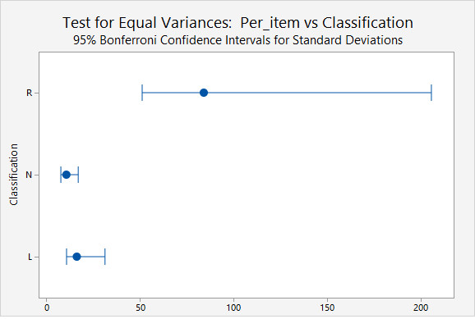
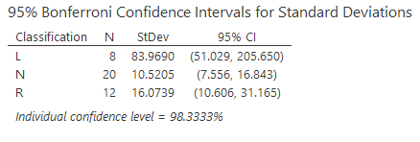
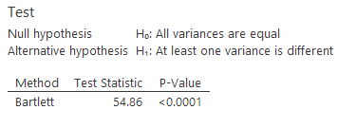
Per Item: Test for Equal Variances

Slide 19
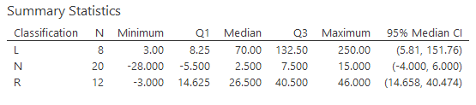
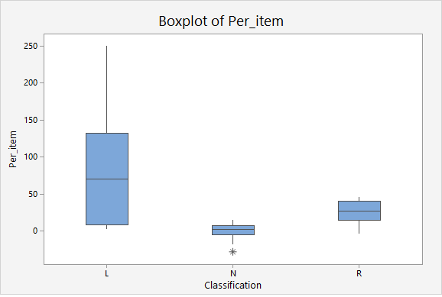
Checking the distribution of our data

Slide 20
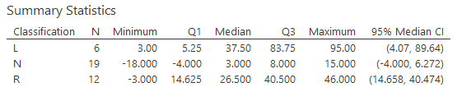
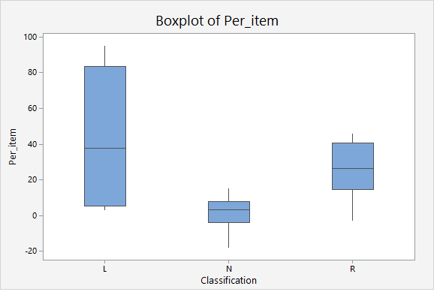
After Removing Outliers

Slide 21
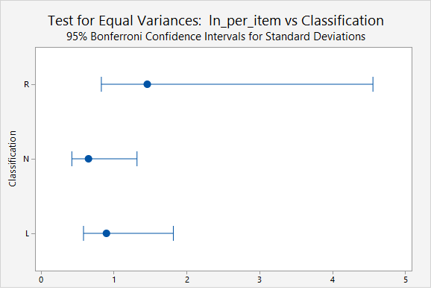
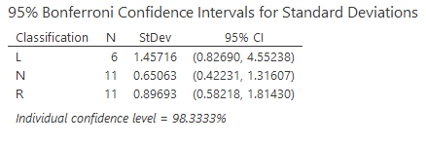
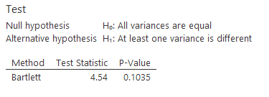
Per Item : Test for Equal Variances

Slide 22
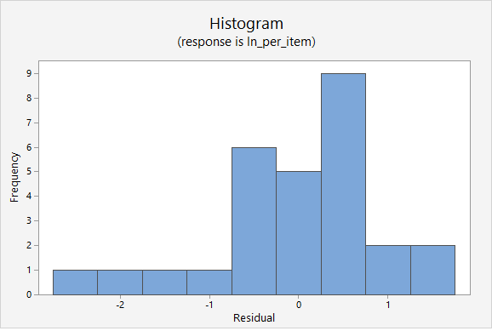
Checking Normality for Residuals

Slide 23
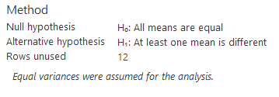
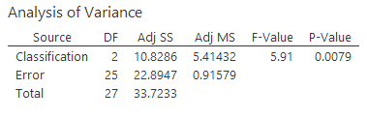

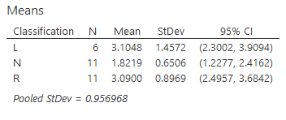

Per Item: One-Way ANOVA

Slide 24
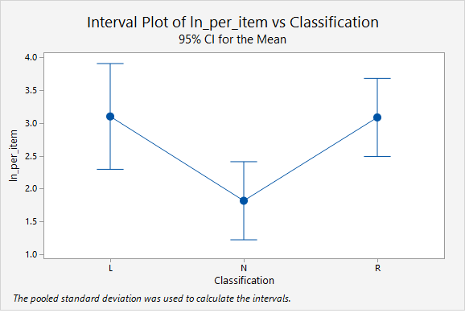
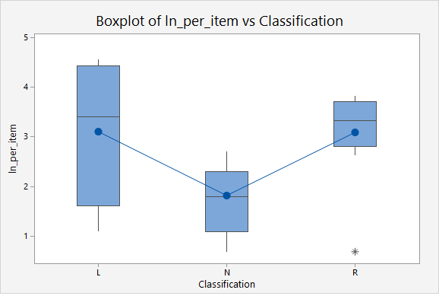
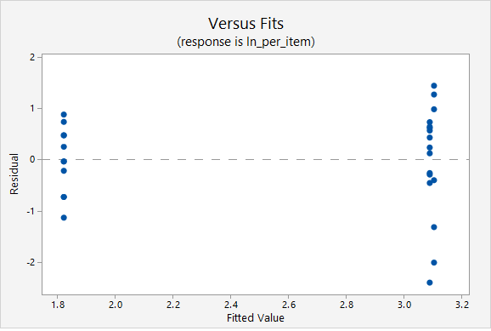
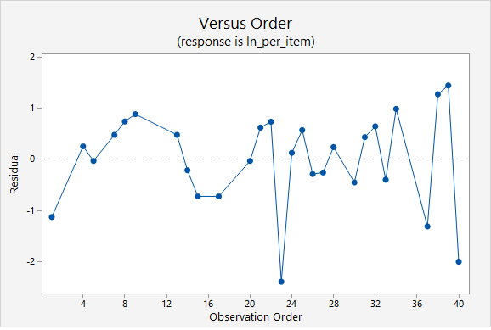

Slide 25
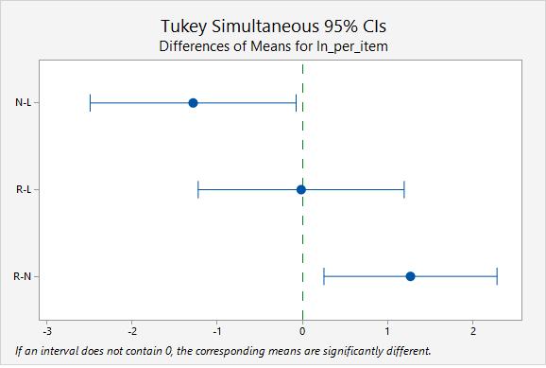
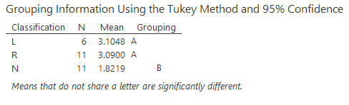
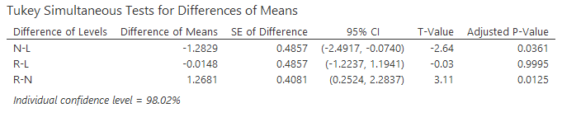
Tukey Method

Slide 26

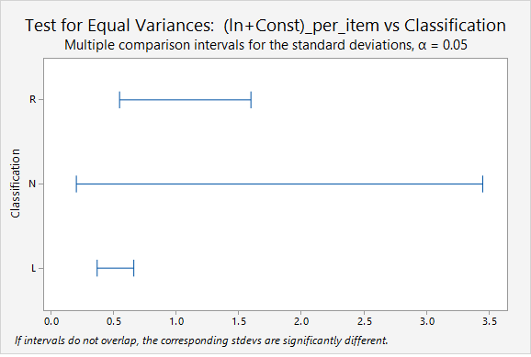
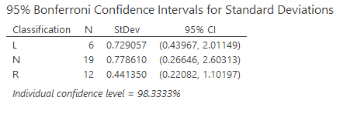
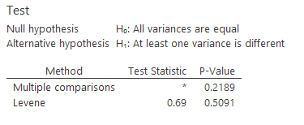
Test for Equal Variances: After adding constant and doing Log Transformation

Slide 27
Checking Normality for Residuals: After adding constant and doing Log Transformation

Slide 28
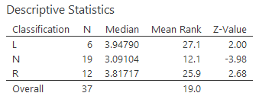
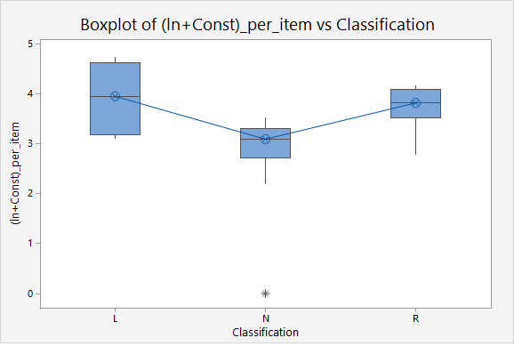
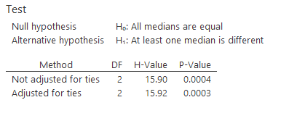
Per Item: Kruskal-Wallis

Slide 29
Conclusion
Regionally distributed food labels per gram had reported significant difference of underreporting of caloric measurement
Average cases of under-reporting for regionally distributed foods per gram exceed those for nationally advertised foods
Nationally advertised foods per item did not have significantly more actual calories than reported
Regionally distributed foods labels per item had significantly more calories than were reported- case of underreporting again!

Slide 30
Conclusion (Continued..)
Locally prepared foods per item had more actual than labeled calories which is again a clear case of underreporting
Nationally advertised foods per item have significantly different average reporting than regionally distributed and locally prepared foods
No significant difference in the average under-reporting between regionally distributed and locally prepared
Nationally advertised foods per item have the least number of under-reporting compared to RD and LP
Food labels may be inadequate sources for caloric monitoring
Accuracy of caloric labeling should be considered when using food labels to help monitor one’s caloric intake

